Slide 1
Pedestrian Detection and Localization
Members:
Đặng Trương Khánh Linh 0612743
Bùi Huỳnh Lam Bửu 0612733
Advisor:
A.Professor Lê Hoài Bắc
UNIVERSITY OF SCIENCE
ADVANCED PROGRAM IN COMPUTER SCIENCE
Year 2011

Slide 2
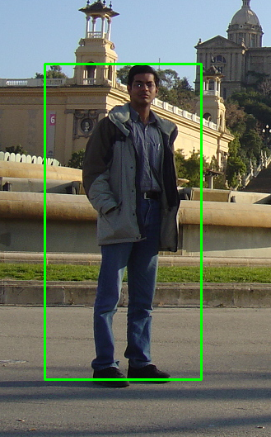
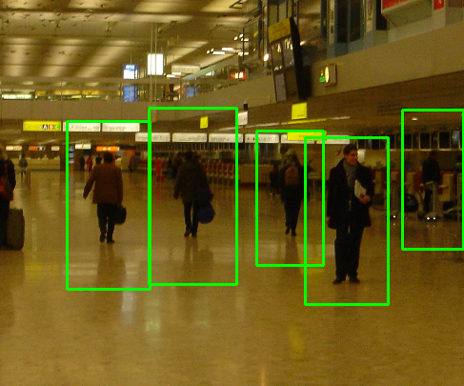
Problem statement
Build up a system which automatically detects and localizes pedestrians in static image.
Pedestrians: up-right and fully visible.

Slide 3
Applications
Automated Automobile Driver , or smart camera in general.
Build a software to categorize personal album images to proper catalogue.
Video tracking smart surveillance.
Action recognition.

Slide 4
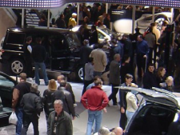
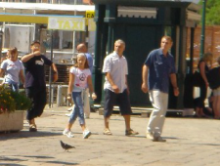
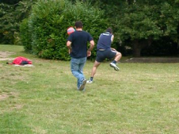
Challenges
Huge variation in intra-class.
Variable appearance and clothing.
Complex background.
Non-constraints illumination.
Occlusions, different scales.

Slide 5
Outline
Existing approaches.
Motivation.
Overview of methodology.
Learning phase
Detection
Our contributions:
Spatial selective approach
Multi-level based approach
Fusion Algorithm
Conclusions
Future work
Reference

Slide 6

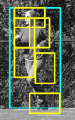

Existing approaches
Haar wavelets + SVM: Papageorgiou & Poggio, 2000; Mohan et al 2000
Rectangular differential features + adaBoost: Viola & Jones, 2001
Model based methods: Felzenszwalb 2008
Lowe, 1999 (SIFT).
Local Binary Pattern: Wang 2009
Histogram of Oriented Gradients: Dalal and Trigg 2005
Felzenszwalb
CVPR 2008
Wang
ICCV 2009

Slide 7
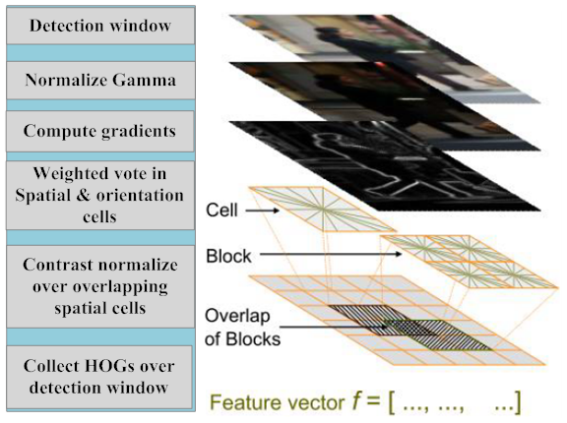
Histogram of Oriented Gradients (HOG)
Base on the gradient of pixels.

Slide 8
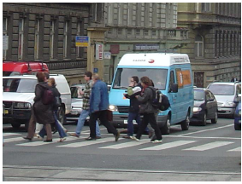
Histogram of Oriented Gradients Review
block
cell
9 orientation bins
0 - 180° degrees
Feature vector
f = […,…,…, ,…]
normalize
9x4 feature vector per cell

Slide 9
Histogram of Oriented Gradients Review
block
cell
9 orientation bins
0 - 180° degrees
Feature vector
f = […,…,…, ,…]
normalize
9x4 feature vector per cell

Slide 10
Histogram of Oriented Gradients Review
block
cell
9 orientation bins
0 - 180° degrees
Feature vector
f = […,…,…, ,…]
normalize
9x4 feature vector per cell

Slide 11
Histogram of Oriented Gradients Review
block
cell
9 orientation bins
0 - 180° degrees
Feature vector
f = […,…,…, ,…]
normalize
9x4 feature vector per cell

Slide 12
SVM Review

Slide 13
Motivation of choosing HOG
The blob structure based methods have fail to object detection problem.
Object detection methods via edge detection are unreliable.
Use the advantage of rigid shape of object.
Has a good performance and low complexity.

Slide 14
Contributions
Re-implement HOG-based pedestrian detector.
Spatial Selective Method.
Multi-level Method.

Slide 15
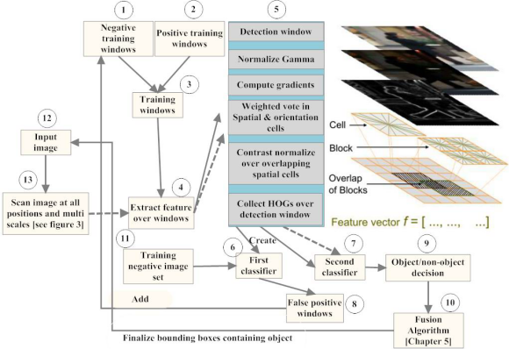
Overview of methodology

Slide 16
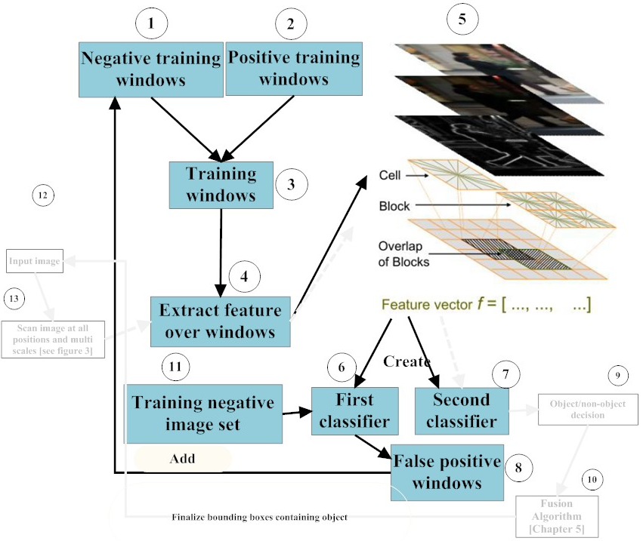
Learning Phase

Slide 17
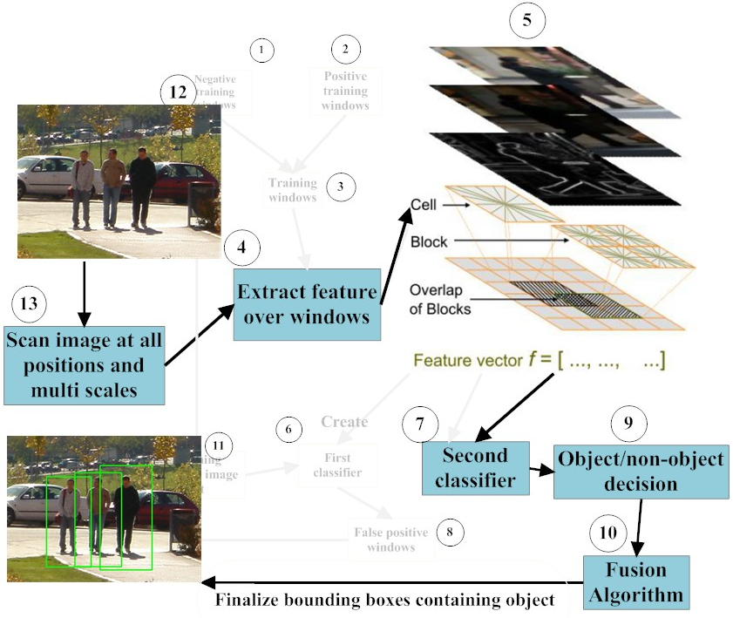
Detection Phase

Slide 18
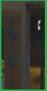
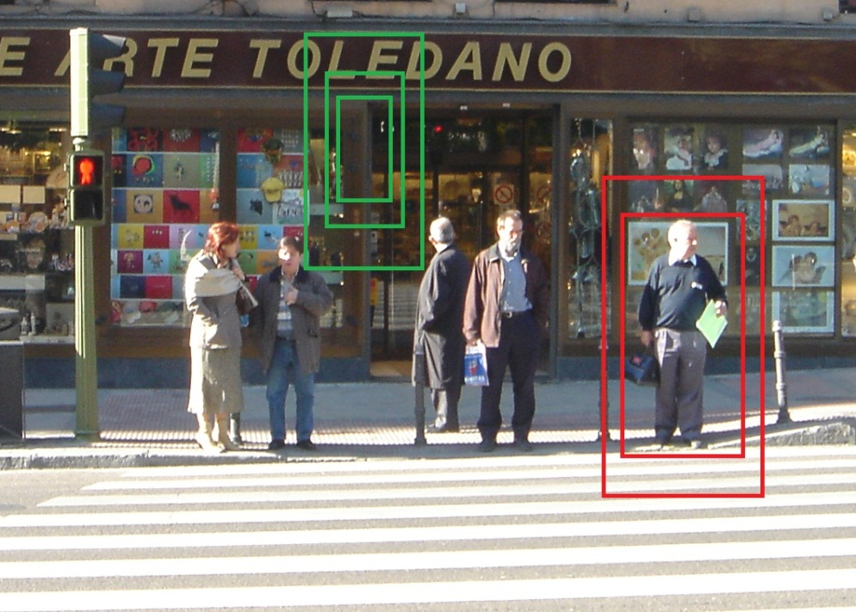
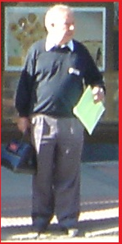
Scan image at all positions and scales
Object/Non-object classifier

Slide 19
Contributions
IMPROVEMENTS
PERFORMANCE
(Spatial Selective Approach)
ACCURACY
(Multi-Level Approach)

Slide 20
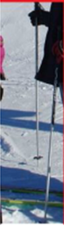
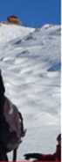
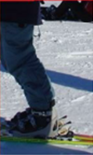
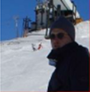
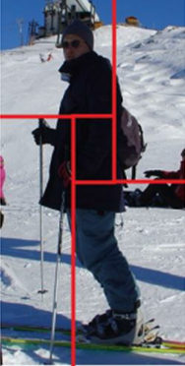
Spatial Selective Approach
Less informative region
Descriptor
[A1,..,Z1]
[A2,..,Z2]
[A3,..,Z3]
[A4,..,Z4]
[A1,..,Z1, A2,..,Z2, A3,..,Z3, A4,..,Z4]

Slide 21
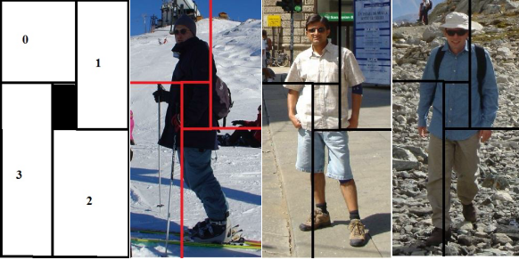
Spatial Selective Approach
Examples:

Slide 22
Multi-level Approach
Purpose: enhance the performance by getting more information about shape of object.
Diff distance

Slide 23

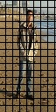
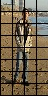
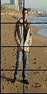
Multi-level Approach
HOG
[A1,..,Z1]
[A2,..,Z2]
[A3,..,Z3]
[A1,..,Z1, A2,..,Z2, A3,..,Z3, A4,..,Z4]

Slide 24
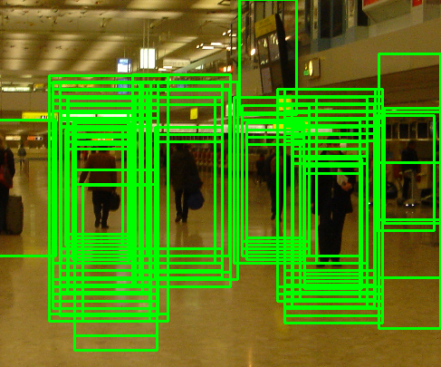
Fusion Algorithm

Slide 25
Mean shift
Region of
interest
Center of
mass
Mean Shift
vector
Slide by Y. Ukrainitz & B. Sarel

Slide 26
Mean shift
Region of
interest
Center of
mass
Mean Shift
vector
Slide by Y. Ukrainitz & B. Sarel

Slide 27
Mean shift
Region of
interest
Center of
mass
Mean Shift
vector
Slide by Y. Ukrainitz & B. Sarel

Slide 28
Mean shift
Region of
interest
Center of
mass
Mean Shift
vector
Slide by Y. Ukrainitz & B. Sarel

Slide 29
Mean shift
Region of
interest
Center of
mass
Mean Shift
vector
Slide by Y. Ukrainitz & B. Sarel

Slide 30
Mean shift
Region of
interest
Center of
mass
Mean Shift
vector
Slide by Y. Ukrainitz & B. Sarel

Slide 31
Mean shift
Region of
interest
Center of
mass
Slide by Y. Ukrainitz & B. Sarel

Slide 32
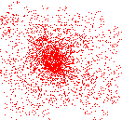
Mean shift clustering
Cluster: all data points in the attraction basin of a mode
Attraction basin: the region for which all trajectories lead to the same mode
Slide by Y. Ukrainitz & B. Sarel

Slide 33
Non-maximum suppression
Using non-maximum suppression such as mean shift to find the modes.

Slide 34
Experiments
Re-implement Dalal‘s Method
Spatial Selective Method
Multi-Level Method

Slide 35
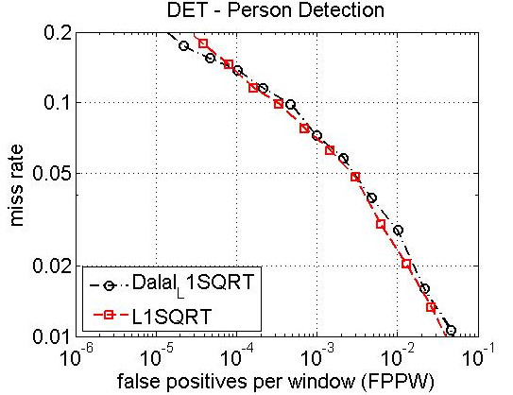
Result of re-implementation

Slide 36
Examples

Slide 37
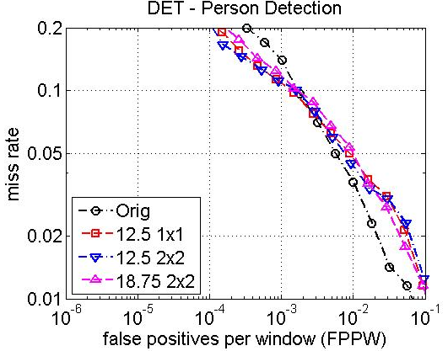
Result Spatial Selective Method

Slide 38
Vector Length v.s Speed
A:B → Deleted cell(s): Overlap cell(s)

Slide 39
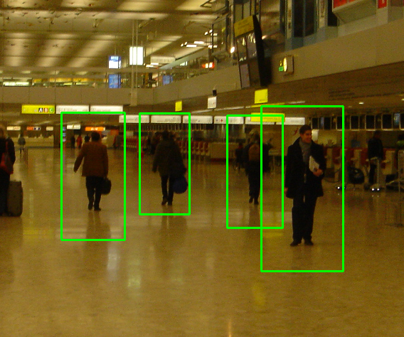

Examples
Original
Re-implement

Slide 40
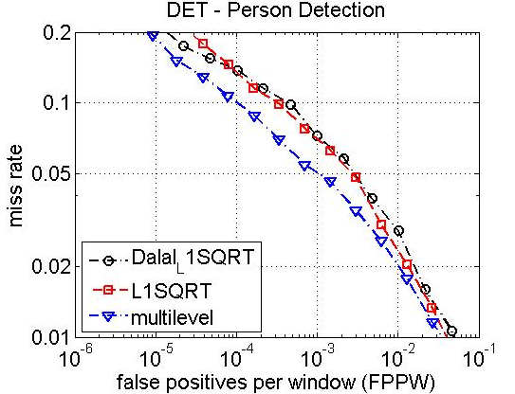
Result Multi-Level

Slide 41
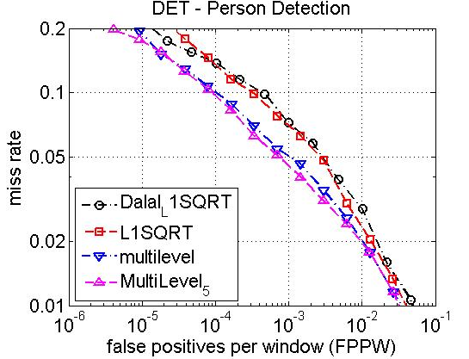
Result(cont…)

Slide 42
Feature vector length v.s time

Slide 43
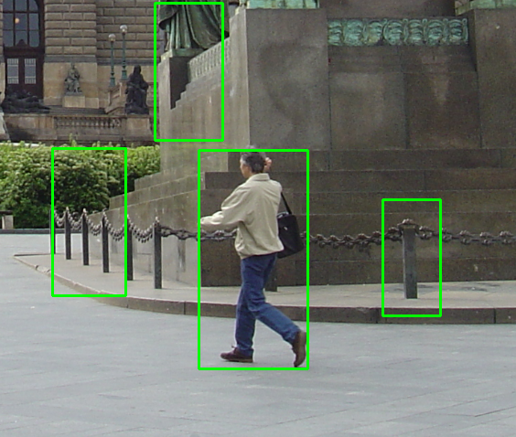
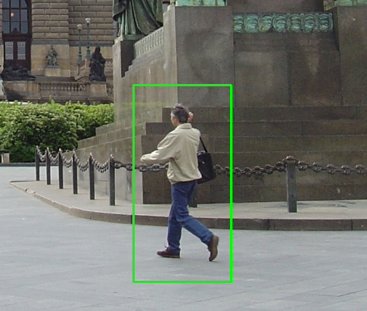
Examples
Original
Multi-level

Slide 44
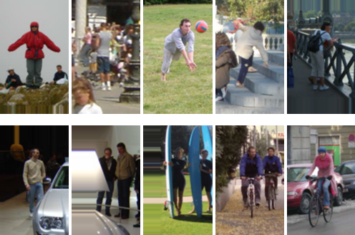
Dataset
INRIA pedestrian dataset
Train: 1208 positive windows 1218 negative images
Test: 566 positive windows 453 negative images

Slide 45
Conclusions
Successfully re-implement HOG descriptor.
Propose the Spatial Selective Approach which take advantages of less informative center region of image window.
Multi-level has more information about shape and contour of object.

Slide 46
Future work
Non-uniform grid of points.
Combination of Spatial Selective and Multi-level approach.

Slide 47
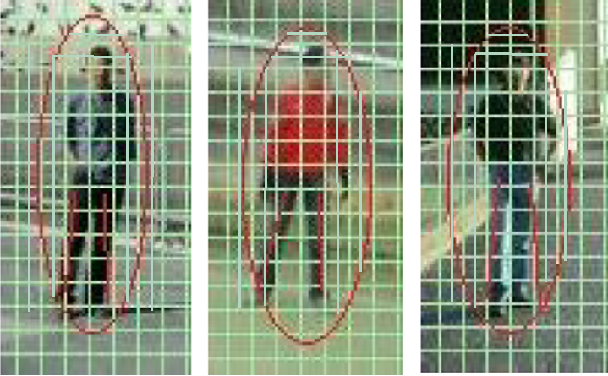
Non-uniform grid of points

Slide 48
References
N. Dalal and B. Triggs, “Histograms of oriented gradients for human detection,” in IEEE Conference on Computer Vision and Pattern Recognition, 2005.
Subhransu Maji et al. Classification using Intersection Kernel Support Vector Machines is Efficient. IEEE Computer Vision and Pattern Recognition 2008
C. Harris and M. Stephens. A combined corner and edge detector. In Alvey Vision Conference, pages 147–151, 1988.
D. G. Lowe. Distinctive image features from scale-invariant keypoints. International Journal of Computer Vision, 60(2):91–110, 2004.

